Slide 1
Review I
Session 14
Henry Lucky, S.Kom. M.Kom.

Slide 2
Outline Materials
Session 14
Divide-and-conquer
Randomized algorithm
Greedy methods
Huffman code
Amortized Analysis

Slide 3
Learning outcomes
LO 1: Explain fundamental concept of analysis algorithms
LO 2: Apply algorithm techniques and methods
LO 3: Solve a problem using specific algorithm.
LO 4: Compare several algorithm design methods

Slide 4
Review I
In this session, the lecturer should solve the problems together with students or guide the students to solve each problems presented from each materials.

Slide 5
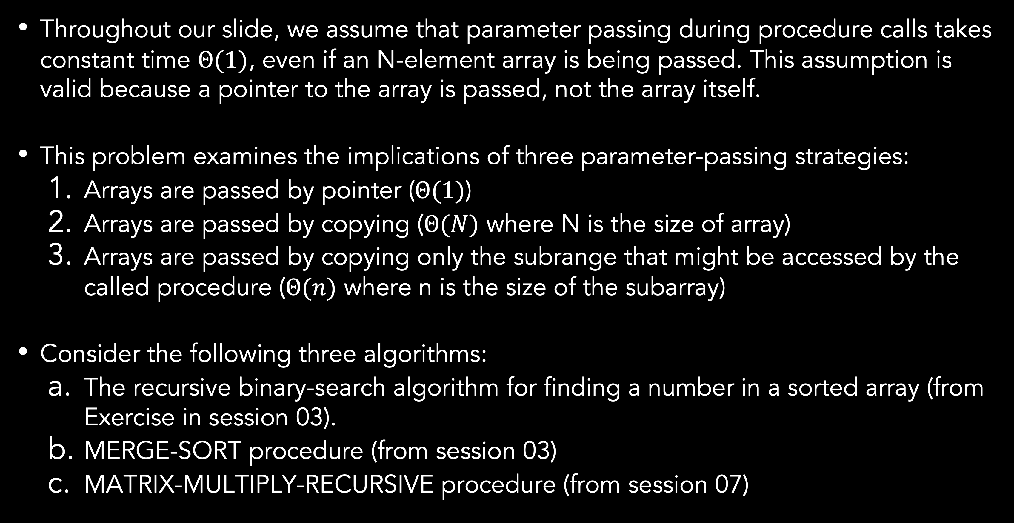
Divide-and-Conquer
Parameter-passing costs
Throughout our slide, we assume that parameter passing during procedure calls takes constant time $Θ(1)$, even if an N-element array is being passed. This assumption is valid because a pointer to the array is passed, not the array itself.
This problem examines the implications of three parameter-passing strategies:
Arrays are passed by pointer ($Θ(1)$)
Arrays are passed by copying ($Θ(N)$ where N is the size of array)
Arrays are passed by copying only the subrange that might be accessed by the called procedure ($Θ(n)$ where n is the size of the subarray)
Consider the following three algorithms:
The recursive binary-search algorithm for finding a number in a sorted array (from Exercise in session 03).
MERGE-SORT procedure (from session 03)
MATRIX-MULTIPLY-RECURSIVE procedure (from session 07)

Slide 6
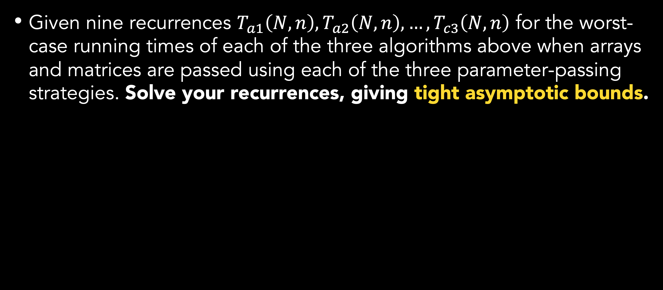
Divide-and-Conquer
Parameter-passing costs
Given nine recurrences $T_{a1}\left(N, n\right), T_{a2}\left(N, n\right), …,T_{c3}\left(N, n\right)$ for the worst-case running times of each of the three algorithms above when arrays and matrices are passed using each of the three parameter-passing strategies. Solve your recurrences, giving tight asymptotic bounds.

Slide 7
Randomized algorithm
Searching an unsorted array
This problem examines three algorithms for searching for a value x in an unsorted array consisting of n elements.
First, consider a randomized strategy: pick a random index i into A. If A[i] = x, then terminate; otherwise, continue the search by picking a new random index into A. Continue picking random indices into A until you find an index j such that A[j] = x or until every element of has been checked. This strategy may examine a given element more than once, because it picks from the whole set of indices each time.
Write pseudocode for a procedure RANDOM-SEARCH to implement the strategy above. Be sure that your algorithm terminates when all indices into have been picked.
Suppose that there is exactly one index i such that A[i] = x. What is the expected number of indices into A that must be picked before x is found and RANDOM-SEARCH terminates?
Suppose that there is no indices i such that A[i] = x. What is the expected numbers of indices into A that must be picked before all elements of A have been checked and RANDOM-SEARCH terminates?

Slide 8
Randomized algorithm
Searching an unsorted array
Now, consider a deterministic linear search algorithm. The algorithm, which we call DETERMINISTIC-SEARCH, searches A for x in order, considering A[1], A[2], …, A[n] until either it finds A[i] = x or it reaches the end of the array. Assume that all possible permutations of the input array are equally likely.
Suppose that there is exactly one index i such that A[i] = x. What is the average-case running time of DETERMINISTIC-SEARCH? What is the worst-case running time?
Suppose that there is no indices i such that A[i] = x. What is the average-case running time of DETERMINISTIC-SEARCH? What is the worst-case running time?

Slide 9
Randomized algorithm
Searching an unsorted array
Finally, consider a randomized algorithm SCRAMBLE-SEARCH that first randomly permutes the input array and then runs the deterministic linear search given above on the resulting permuted array.
Suppose that there is exactly one index i such that A[i] = x. What is the worst running time? What is the expected running time?
Suppose that there is no indices i such that A[i] = x. What is the worst running time? What is the expected running time?
Which of the three searching algorithms would you use? Explain your answer.

Slide 10
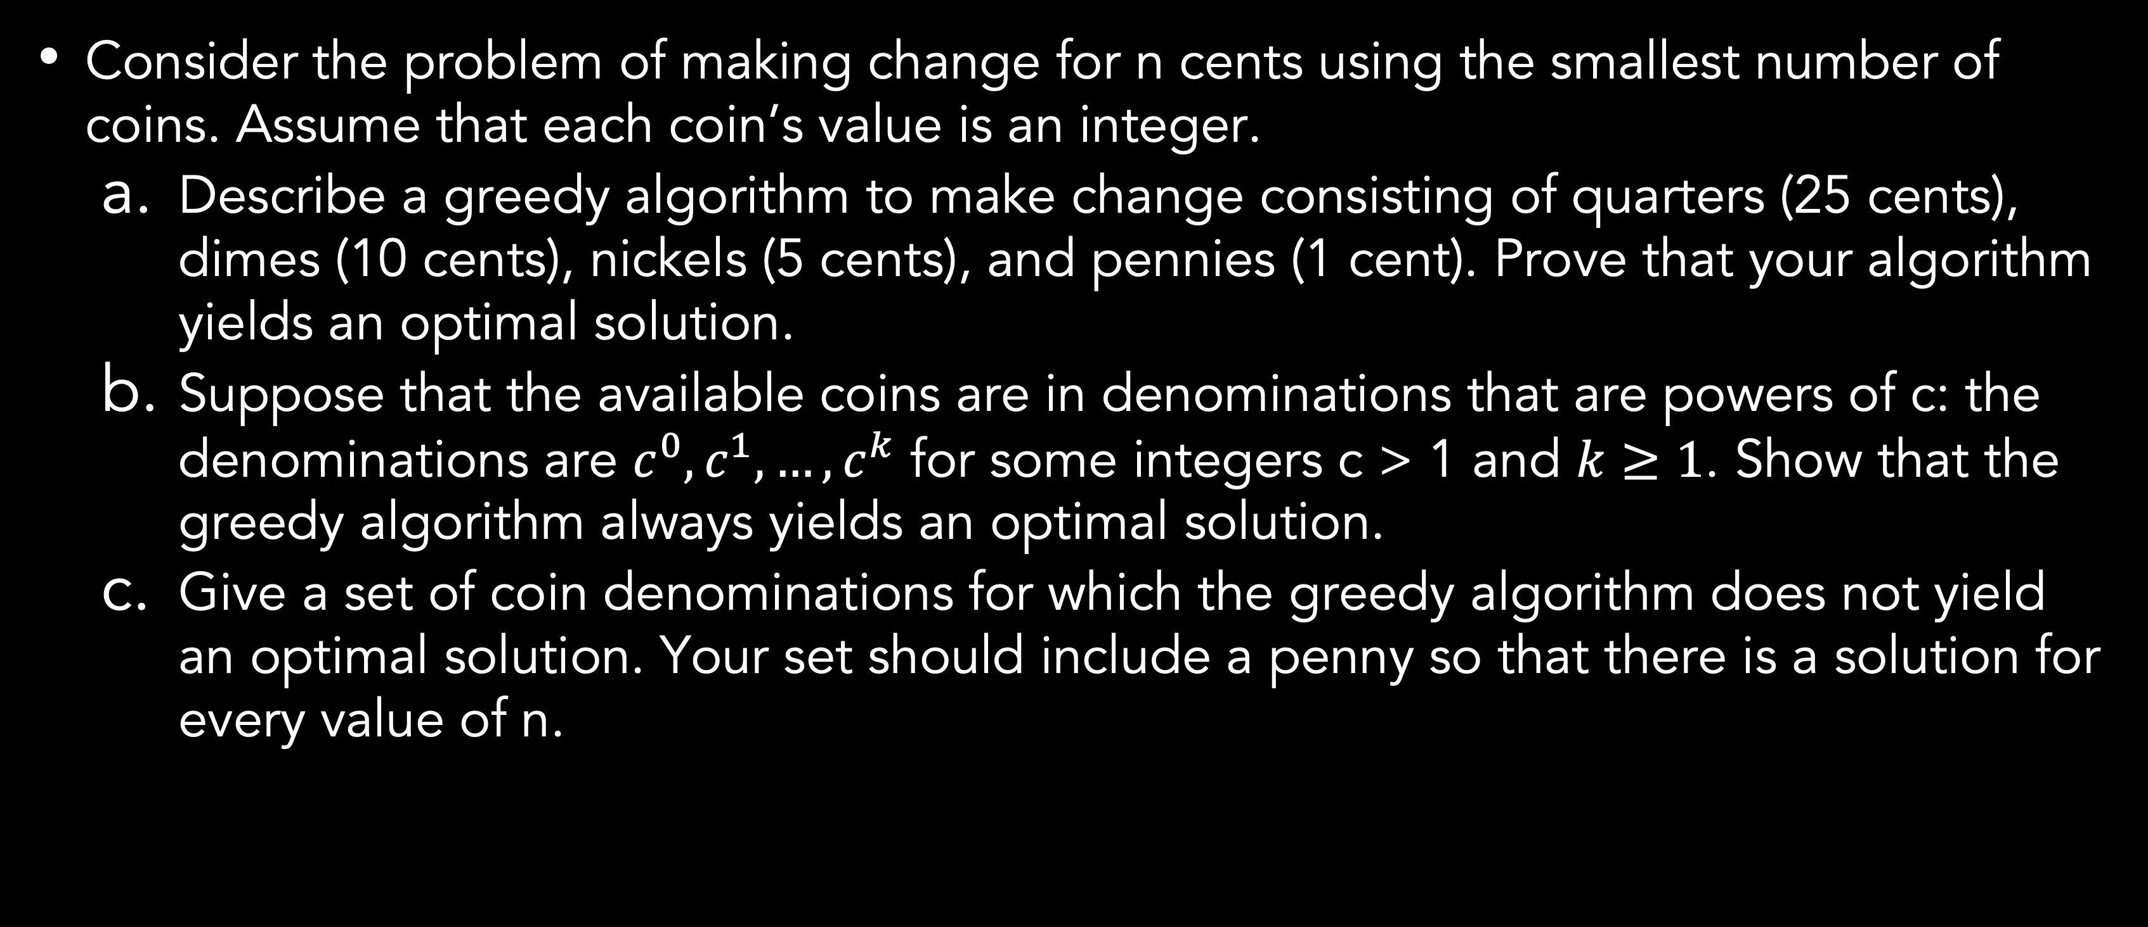
Greedy methods
Coin changing
Consider the problem of making change for n cents using the smallest number of coins. Assume that each coin’s value is an integer.
Describe a greedy algorithm to make change consisting of quarters (25 cents), dimes (10 cents), nickels (5 cents), and pennies (1 cent). Prove that your algorithm yields an optimal solution.
Suppose that the available coins are in denominations that are powers of c: the denominations are $c^{0},c^{1}, …,c^{k}$ for some integers c > 1 and $k≥1$. Show that the greedy algorithm always yields an optimal solution.
Give a set of coin denominations for which the greedy algorithm does not yield an optimal solution. Your set should include a penny so that there is a solution for every value of n.
Notes:
The penny coin is also known as the one-cent coin. The penny coin is worth one cent and it is the American coin of lowest value.
The nickel is an American coin that is worth 5 cents.
A dime is worth 10 cents.
The quarter is an American coin worth 25 cents.
For part B: For example, you might have coins worth 1 cent (c^0), 10 cents (c^1), 100 cents (c^2), and 1000 cents (c^3), when c = 10 and k = 3.

Slide 11
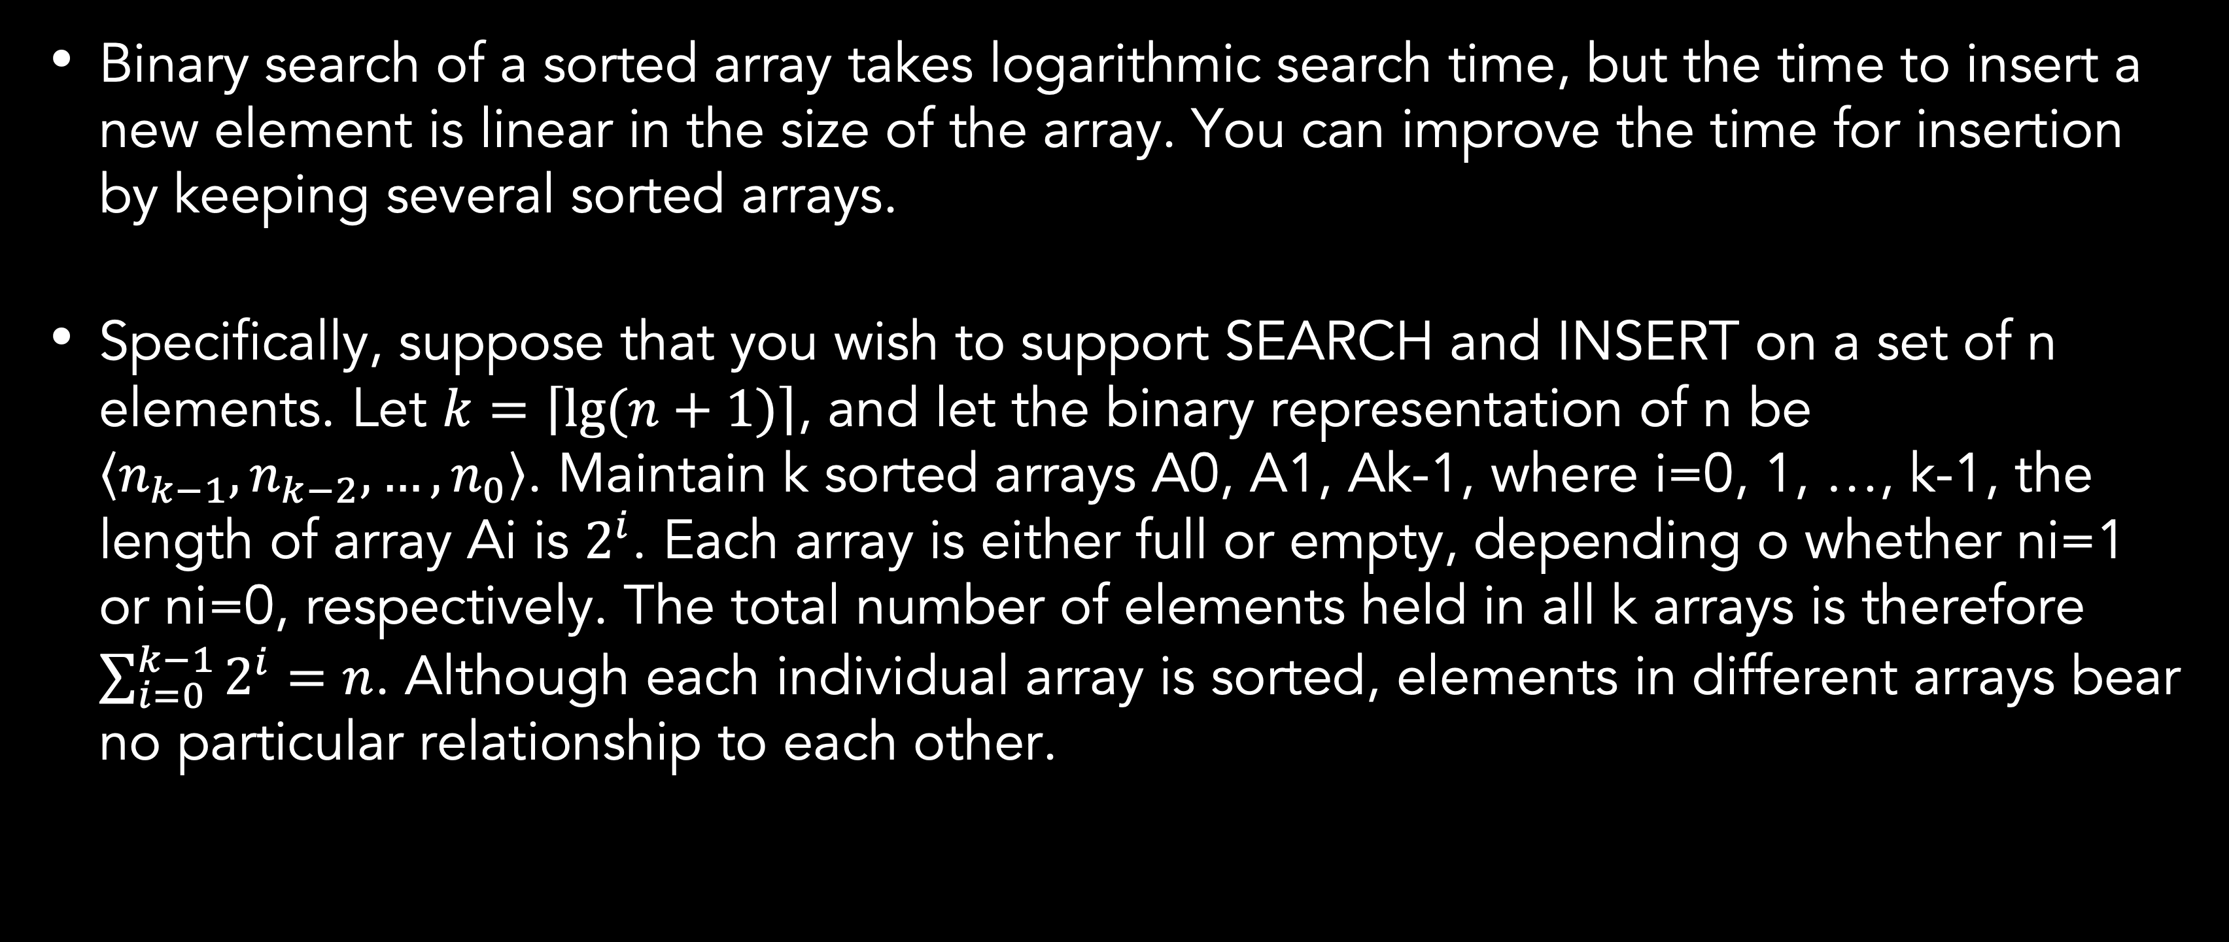
Amortized analysis
Making binary search dynamic
Binary search of a sorted array takes logarithmic search time, but the time to insert a new element is linear in the size of the array. You can improve the time for insertion by keeping several sorted arrays.
Specifically, suppose that you wish to support SEARCH and INSERT on a set of n elements. Let $k=\left\lceil lg⁡(n+1)\right\rceil$, and let the binary representation of n be $\left\langle n_{k−1}, n_{k−2}, …, n_{0}\right\rangle$. Maintain k sorted arrays A0, A1, Ak-1, where i=0, 1, …, k-1, the length of array Ai is $2^{i}$. Each array is either full or empty, depending o whether ni=1 or ni=0, respectively. The total number of elements held in all k arrays is therefore $\sum_{i=0}^{k−1}{2^{i}=n}$. Although each individual array is sorted, elements in different arrays bear no particular relationship to each other.

Slide 12
Amortized analysis
Making binary search dynamic
Based on the data structure mentioned before:
Describe how to perform the SEARCH operation for this data structure. Analyze its worst-case running time.
Describe how to perform the INSERT operation. Analyze its worst-case and amortized running times, assuming that the only operations are INSERT and SEARCH.
Describe how to implement DELETE. Analyze its worst-case and amortized running times, assuming that there can be DELETE, INSERT, and SEARCH operations.

Slide 13
References
Thomas H. Cormen. (2022). Introduction to algorithms: Fourth edition. The MIT Press. Chapter 4, 5, 15, 16.

Slide 14
Thank you
Review I
September, 2023

